Slide 1
The moon

Slide 2
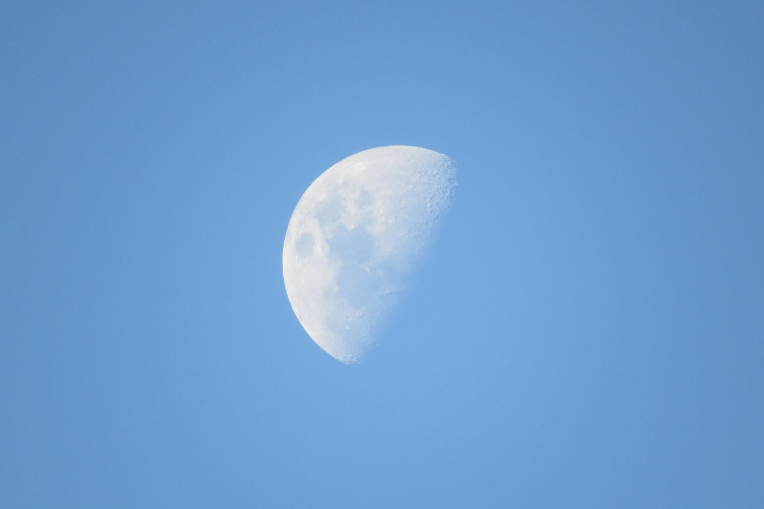
(i)

Slide 3
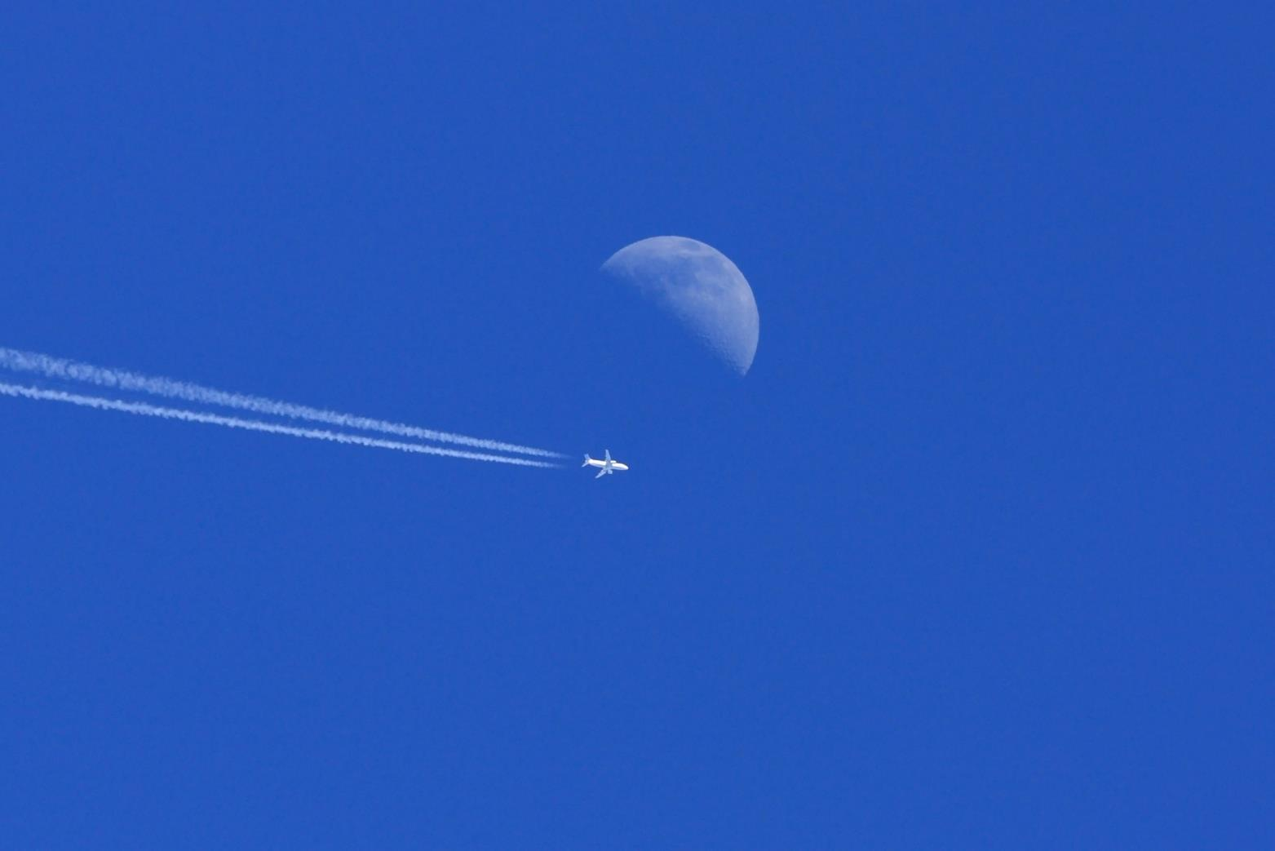
(ii)

Slide 4
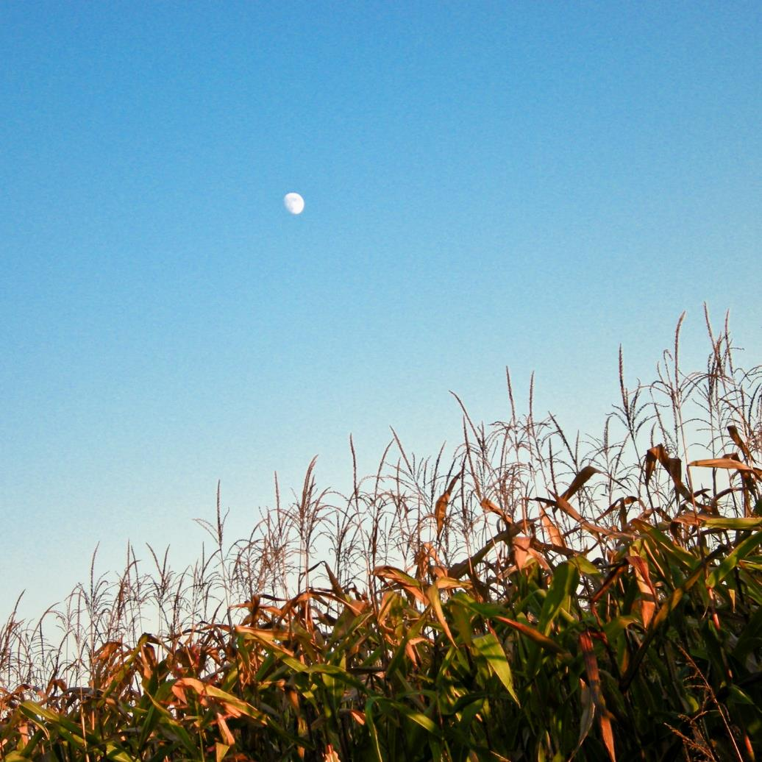
(iii)

Slide 5
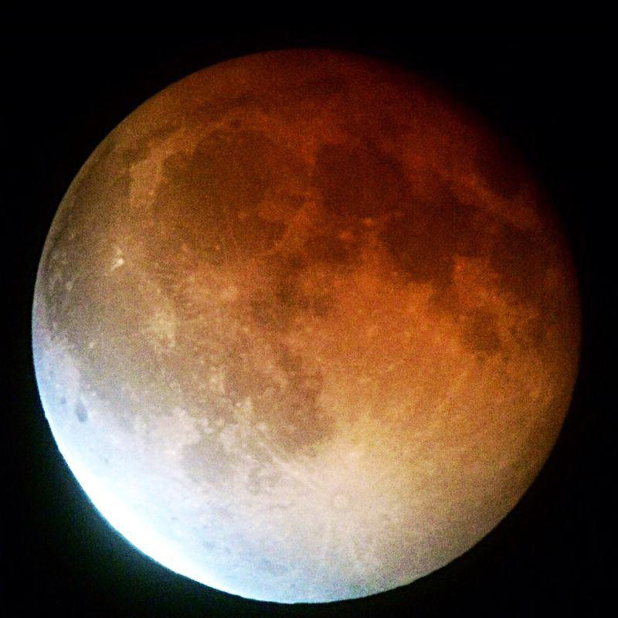
(iv)

Slide 6
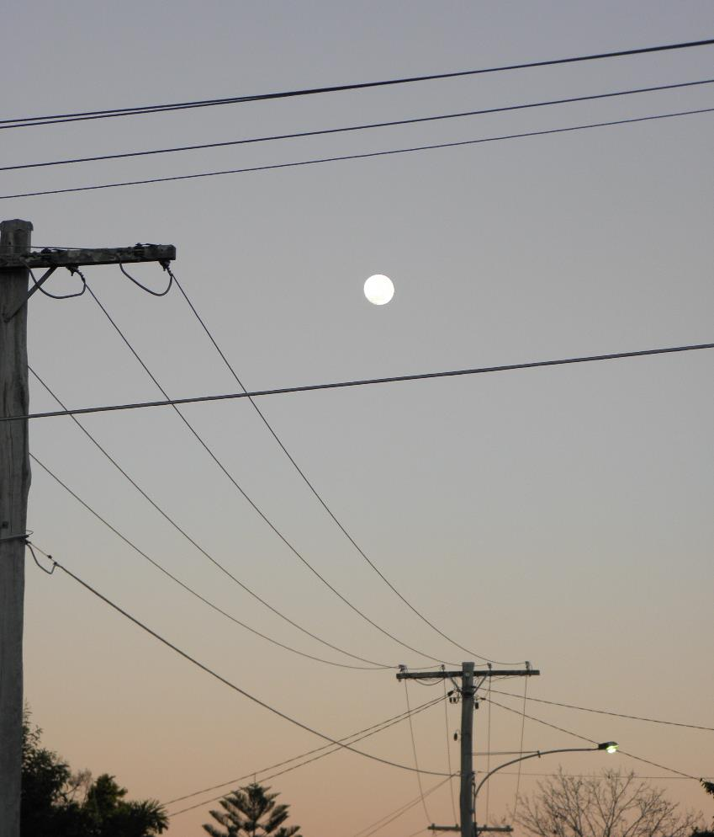
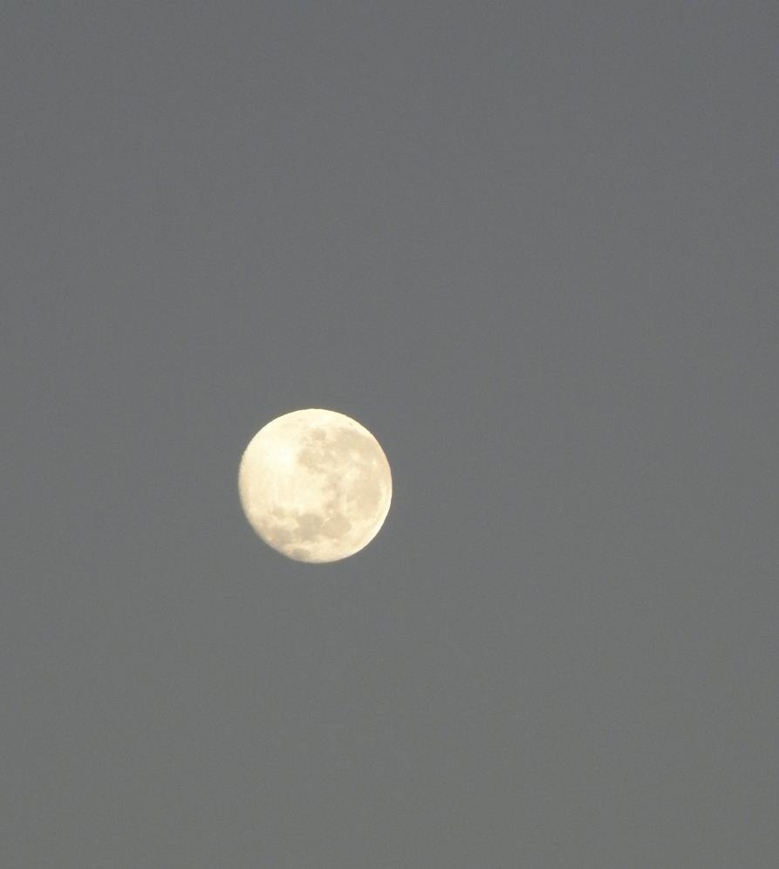
(v)

Slide 7
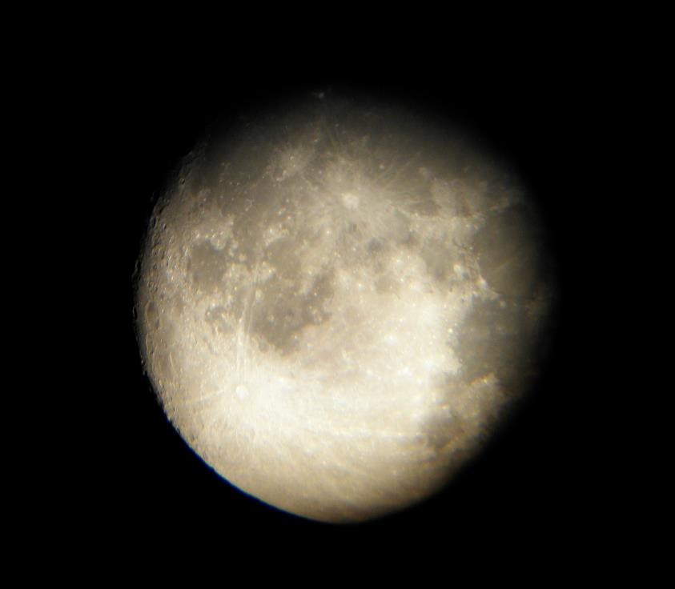
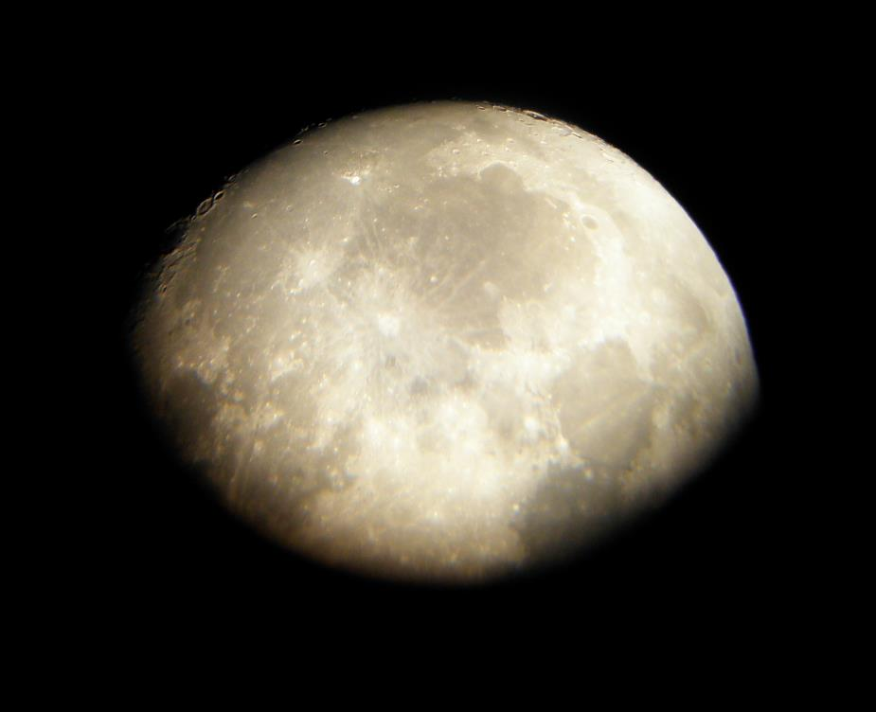
(vi)

Slide 8
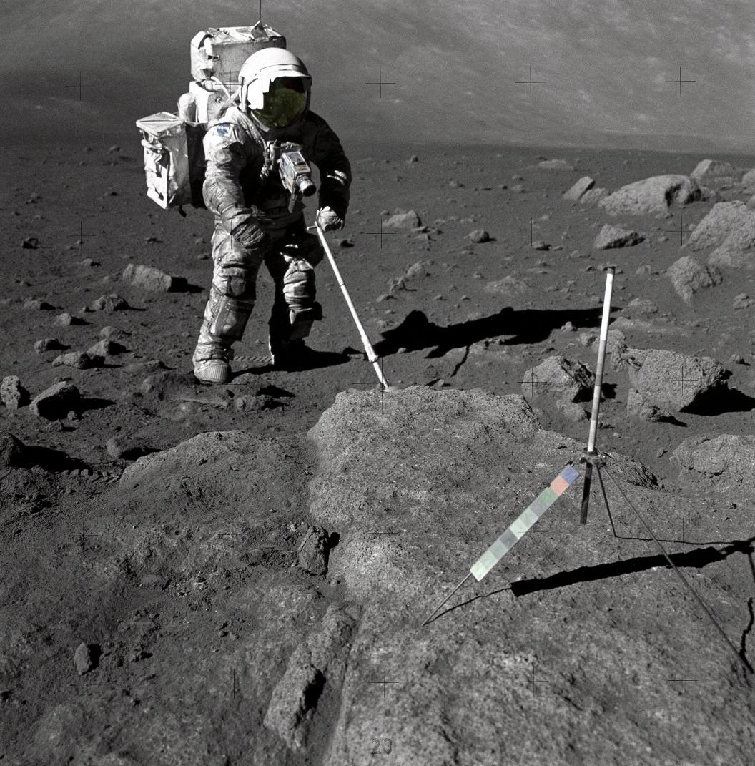
(vii)

Slide 9
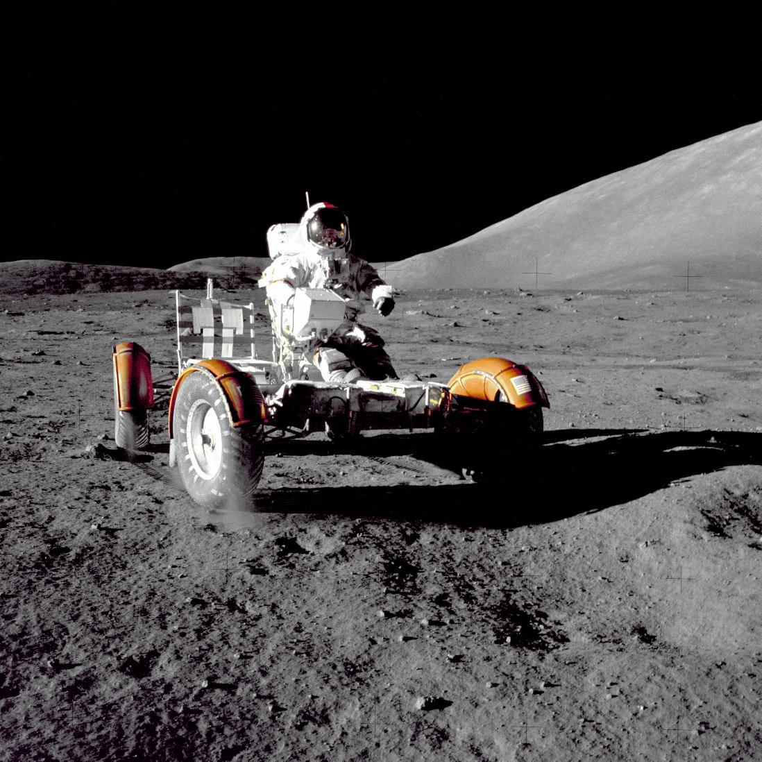
(viii)

Slide 10
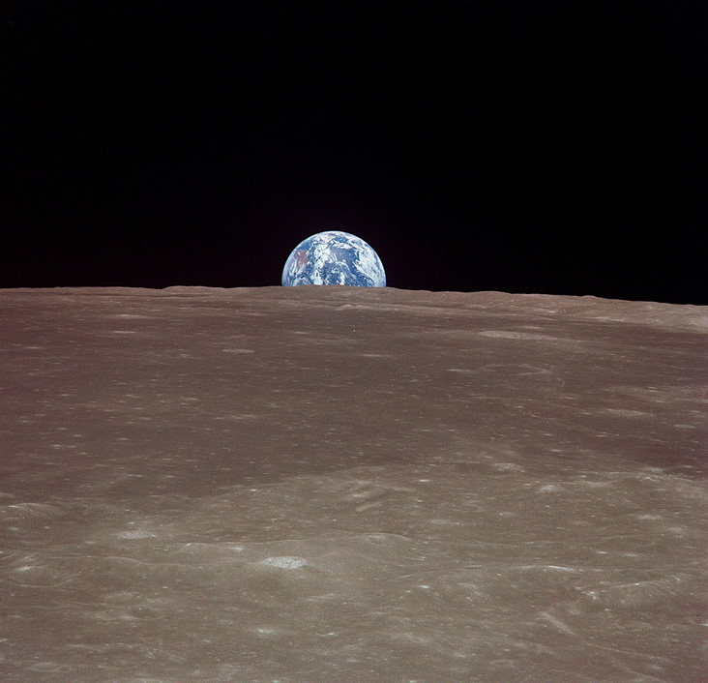
(ix)

Slide 11
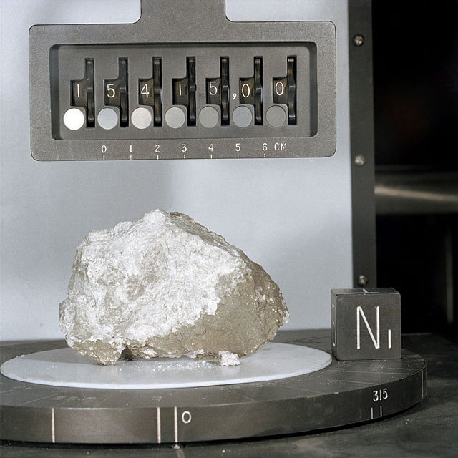
(x)

Slide 12
Attributions
(i) Daytime moon – Morguefile image by Muvuca http://mrg.bz/UF1Ehq
(ii) Daytime moon and plane – Morguefile image by Flying Pete http://mrg.bz/5DB4vO
(iii) Daytime moon and crops – Morguefile image by SQUAIO http://mrg.bz/AolUeg
(iv) Lunar eclipse blood moon – NASA http://solarsystem.nasa.gov/moon/image-display.cfm?IM_ID=19207
(v) Twilight moon 2 & Twilight moon 3 – Courtesy of Shelley Murphy. Used with permission
(vi) Telescopic view of moon at night 1 & 2 – Courtesy of Shelley Murphy. Used with permission
(vii) Sample gathering – NASA http://solarsystem.nasa.gov/moon/image-display.cfm?IM_ID=17909
(viii) Apollo 17 Rover – NASA http://solarsystem.nasa.gov/moon/image-display.cfm?IM_ID=17910
(ix) Earth from the Moon: A Different Perspective on the Harvest Moon – NASA https://solarsystem.nasa.gov/multimedia/display.cfm?Category=Planets&IM_ID=17785
(x) Apollo 15 Genesis rock – NASA
http://en.wikipedia.org/wiki/Moon_rock#mediaviewer/File:Apollo_15_Genesis_Rock.jpg

