Slide 1
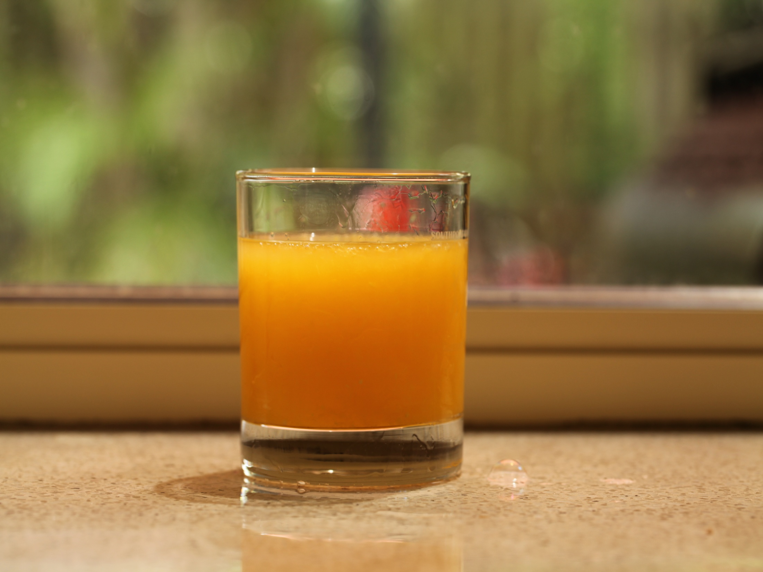

Sugar detectives
Year 1 – Sugar detectives

Slide 2
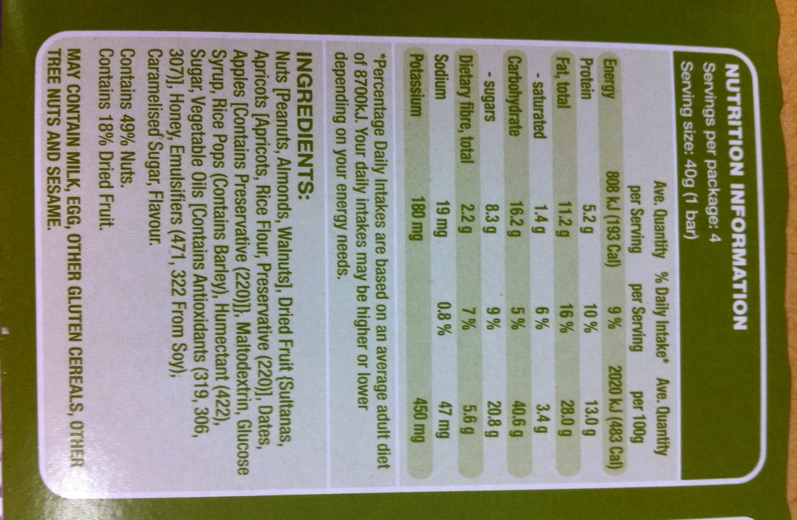
Food label
Ingredients
How healthy the food is

Slide 3
Video
Pyramid Power vs Junk Food Bandits basketball movie
Nourish Interactive http://www.nourishinteractive.com/
Images courtesy of Narinda Sandry, used with permission

