Slide 1
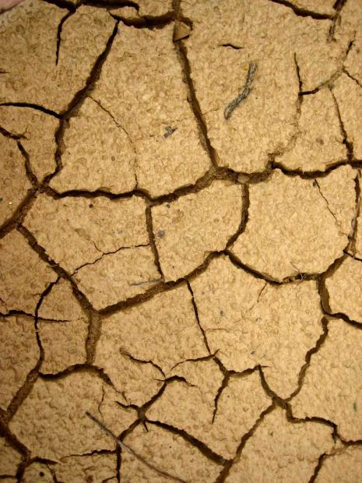
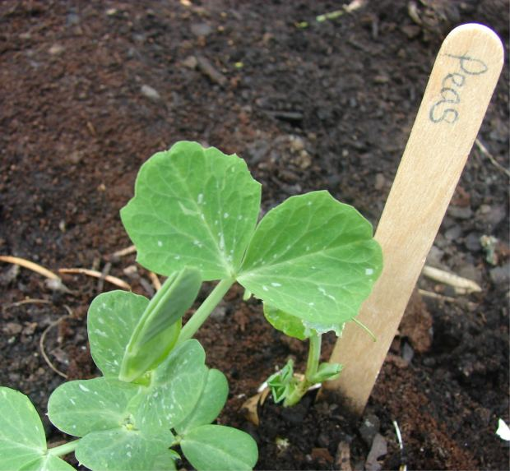
Healthy Soil, Healthy Living

Slide 2

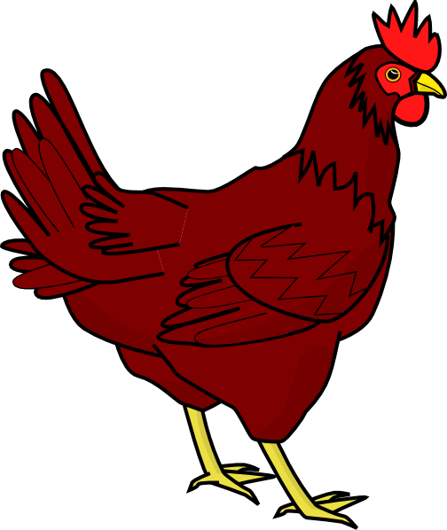




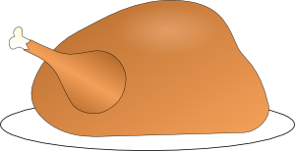
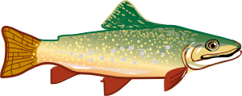
Where does food come from?
Plants
Animals

Slide 3
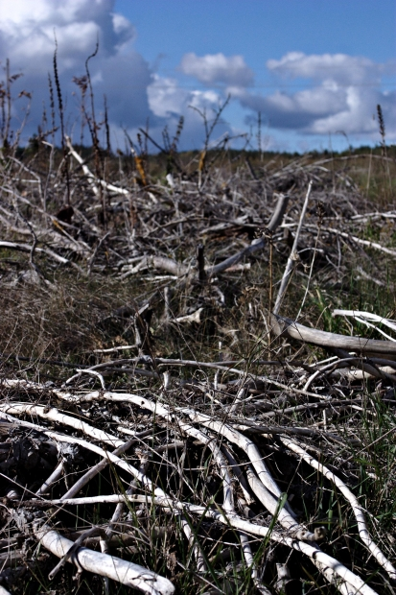
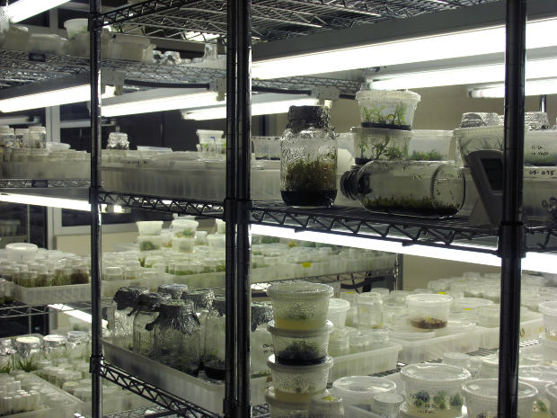
Many scientists study plants and animals because…
sick plants and animals don’t give much food

Slide 4



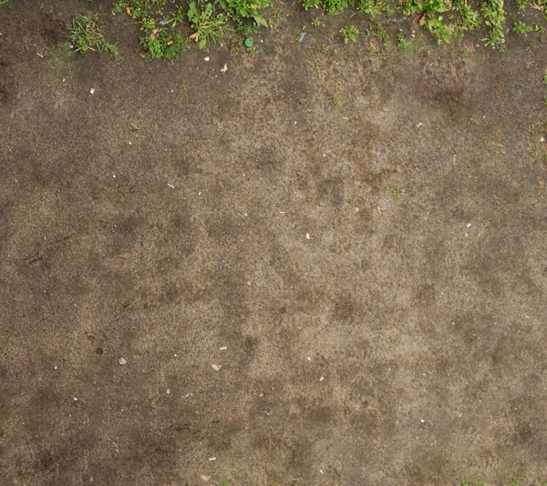
What do we and scientists know are the needs of plants?
water
light and warmth
soil and
a space to grow.
Scientists study these needs so that plants and animals grow the best that they can.

Slide 5
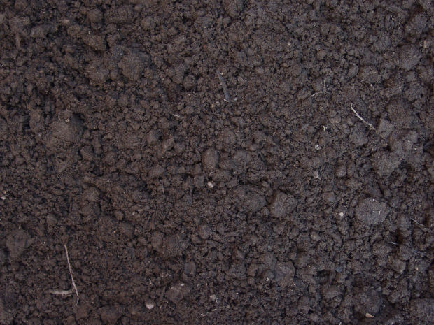
Today’s science lesson is looking at one of these needs…
…healthy soil

Slide 6
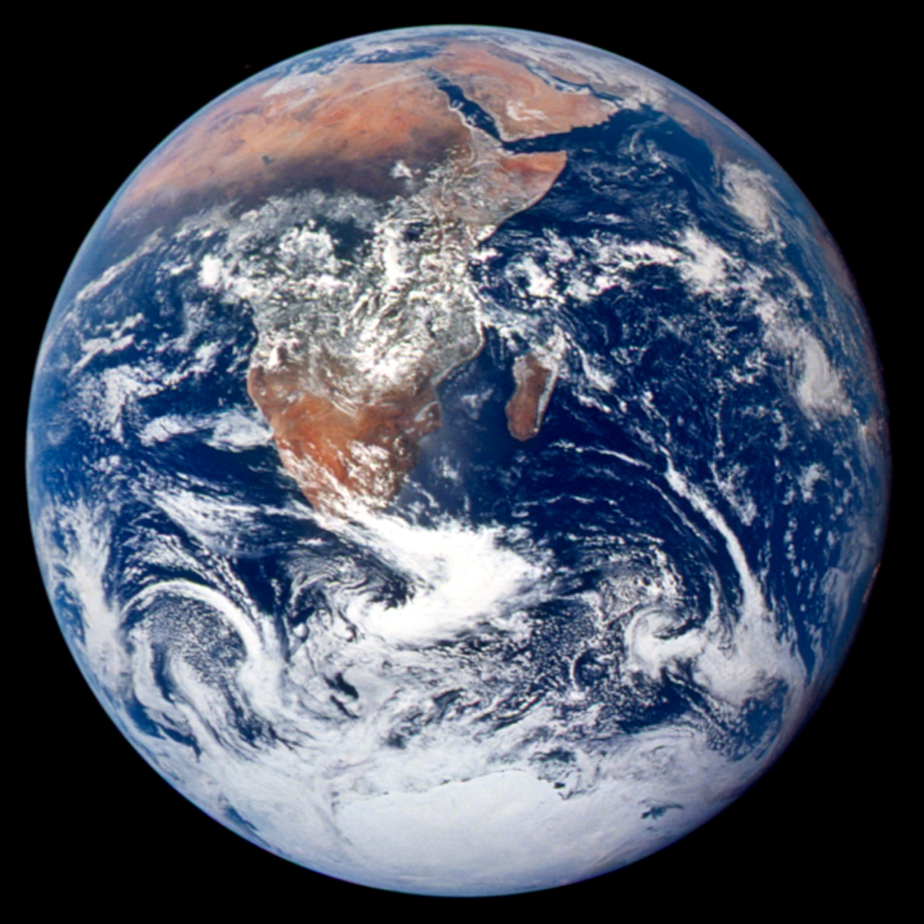
Our home, our planet… Earth
Where can we grow food on our planet? How much usable soil is there on Earth?
Image courtesy NASA Johnson Space Center, http://visibleearth.nasa.gov/view.php?id=55418

Slide 7
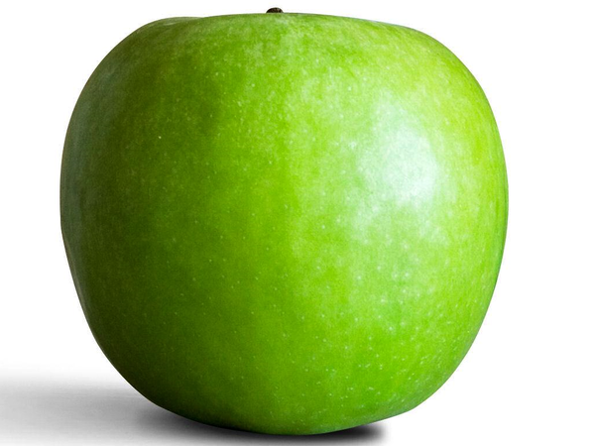
Let’s pretend Earth is an apple!
Earth is, of course, enormous compared to an apple, but sometimes scientists use small versions of things called models to teach us. If things are incredibly big or incredibly small, or for things that are inside our bodies, scientists often make a model. So we are going to pretend that the apple is a model of Earth. (You will use dough.)

Slide 8
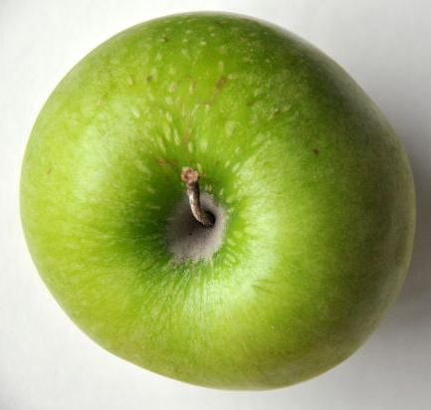
Earth is covered with a lot of water…
In fact, we are going to cut the apple into quarters because ¾ of Earth is water.

Slide 9
Of the quarter of Earth left
½ of that is deserts or the ice areas of Antarctica and the Arctic that produce very little food.

Slide 10
Of the eighth of Earth left
¾ of this is too rocky, too wet, too hot or too cold for food production so…

Slide 11
The skin of this tiny piece of Earth is the only area that is actually good for growing food!

Slide 12
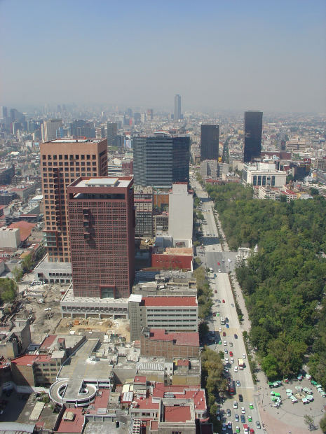
Not only does this little space have to grow all the world’s food, it’s also where most of the people in the world live.

Slide 13

Plus…
Each week there are one and a half million extra people to feed

Slide 14
So this little piece of planet Earth
is very very, very important!

Slide 15
We must learn how to look after the soil so it can continue to feed us!
Video — The life in dirt
ABC Splash (5.19 min) http://splash.abc.net.au/media/-/m/104056/soil-healthy-dirt-makes-healthy-plants

Slide 16
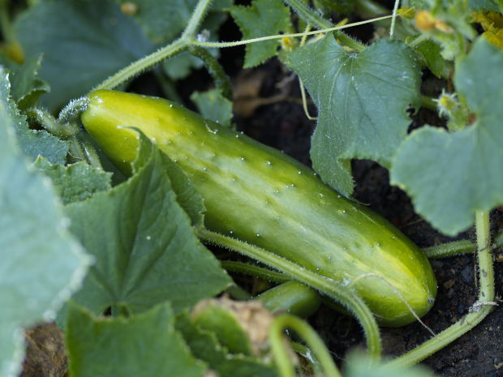
Video—Vegetable gardens
ABC Splash (5.18 min) http://splash.abc.net.au/media/-/m/106432/vegetable-gardens

