Slide 1
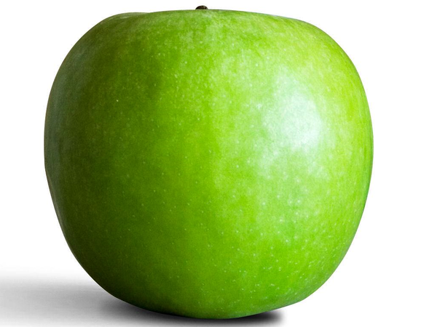

Food detectives
Year F - What’s in your lunch box?

Slide 2
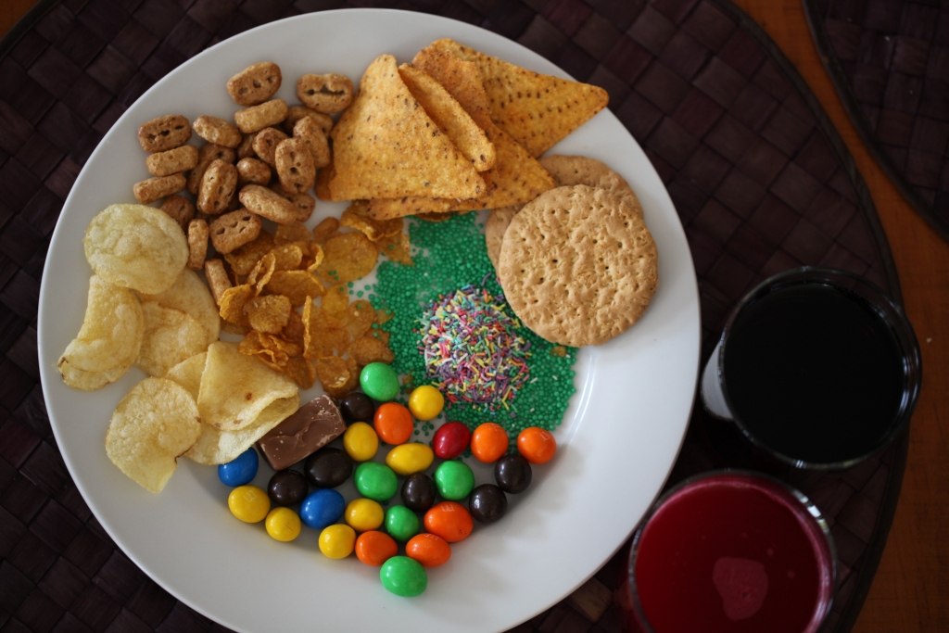
Look at these foods and drinks.
What are their properties?

Slide 3
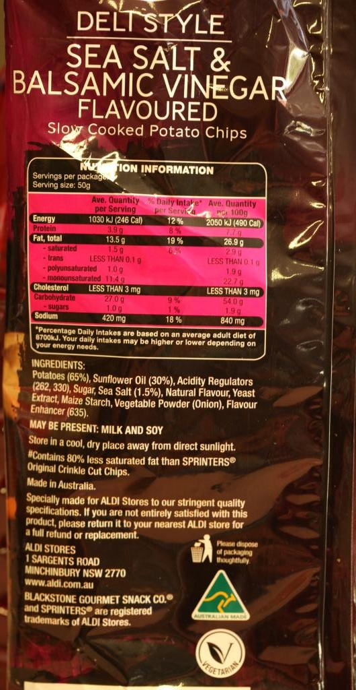
How can we find out what is in our food?
Look for the food information label!

Slide 4
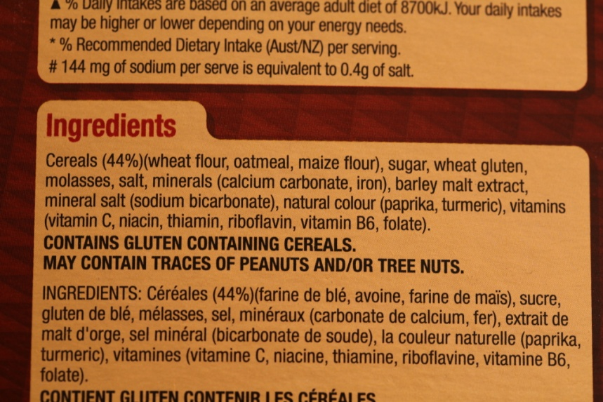
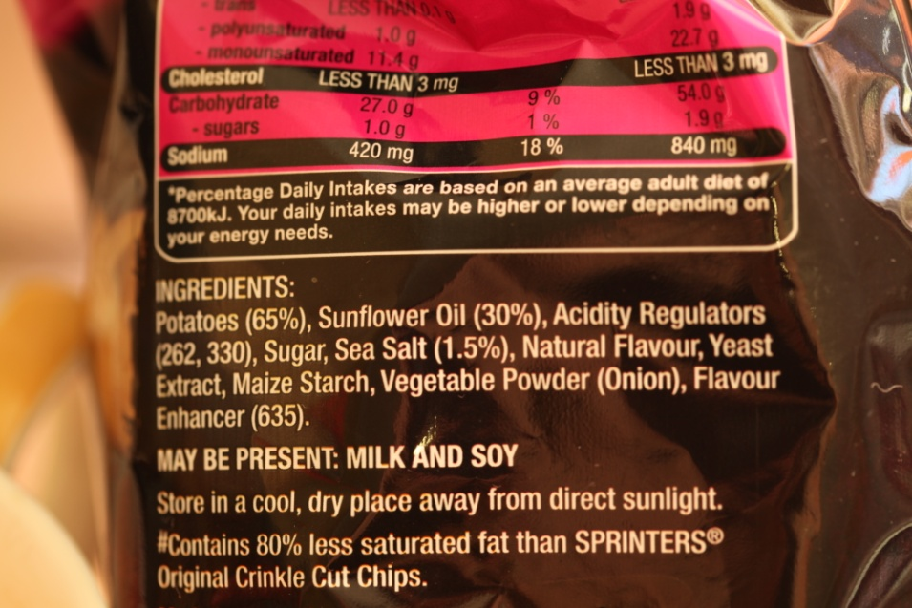
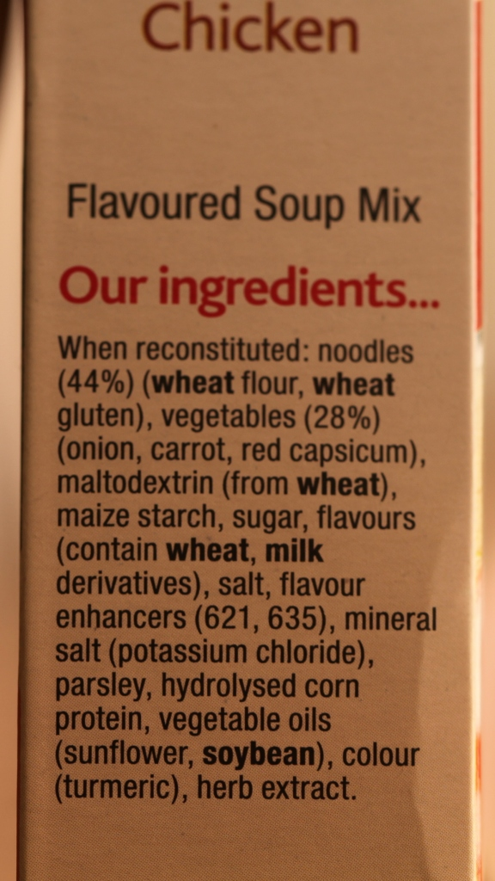
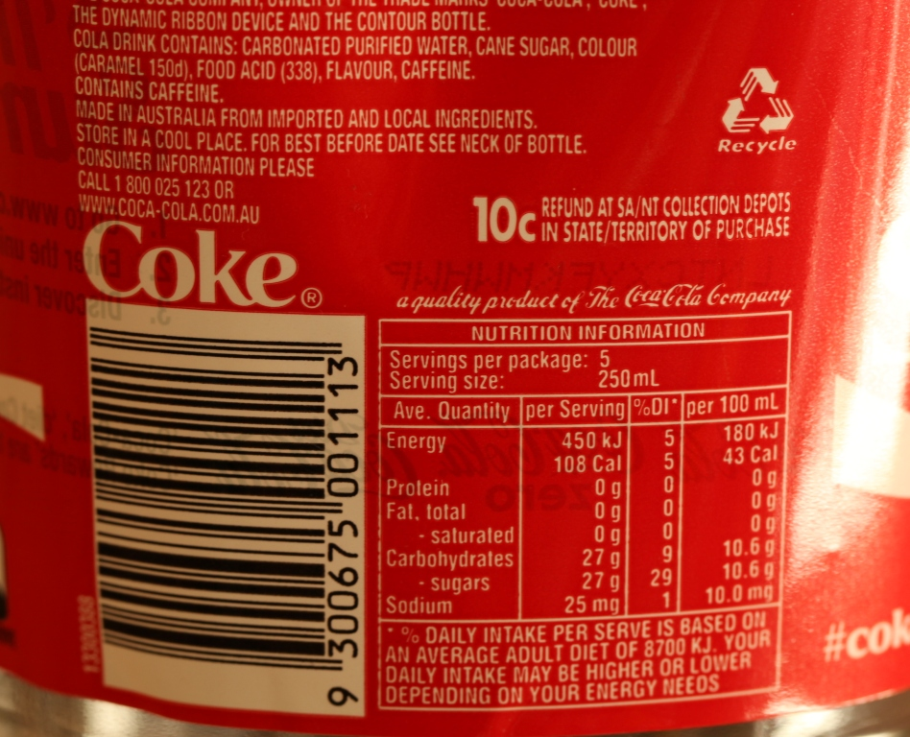
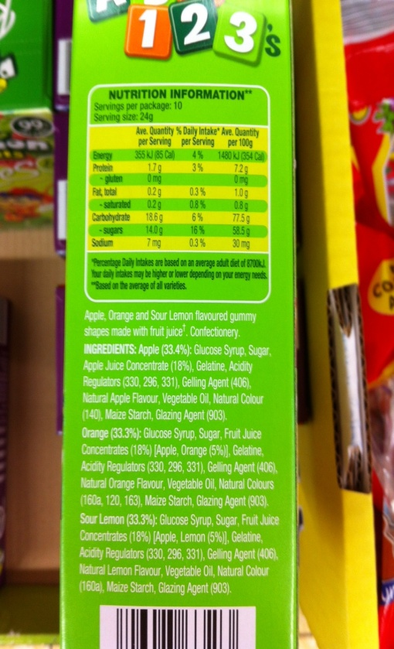
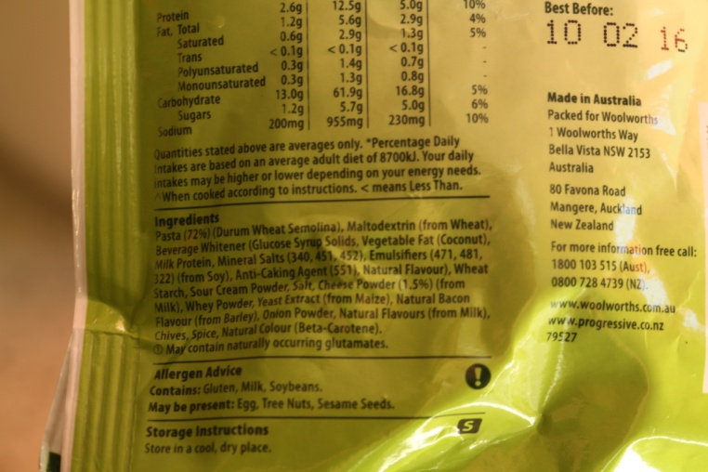

Slide 5
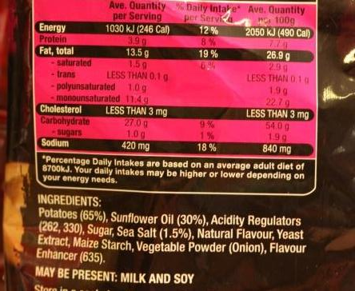
When there are lots of ingredients, especially sugar, salt, oil and flavour… these foods are not as good for us as natural foods.
These chips have 11 ingredients including sugar, salt, oil and flavour !!!!

Slide 6

This chicken flavoured packet soup contains 18 ingredients including salt, flavour, sugar and oil.

Slide 7
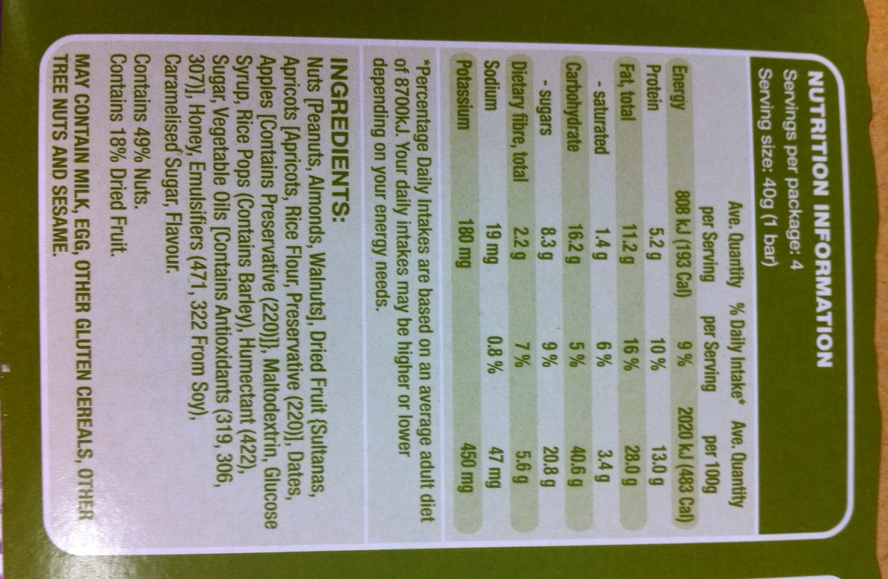
These snack bars have 24 ingredients including lots of sugar and oil!!!

Slide 8
Video
Pyramid Power vs Junk Food Bandits Basketball Movie
Source: Nourish Interactive

Slide 9
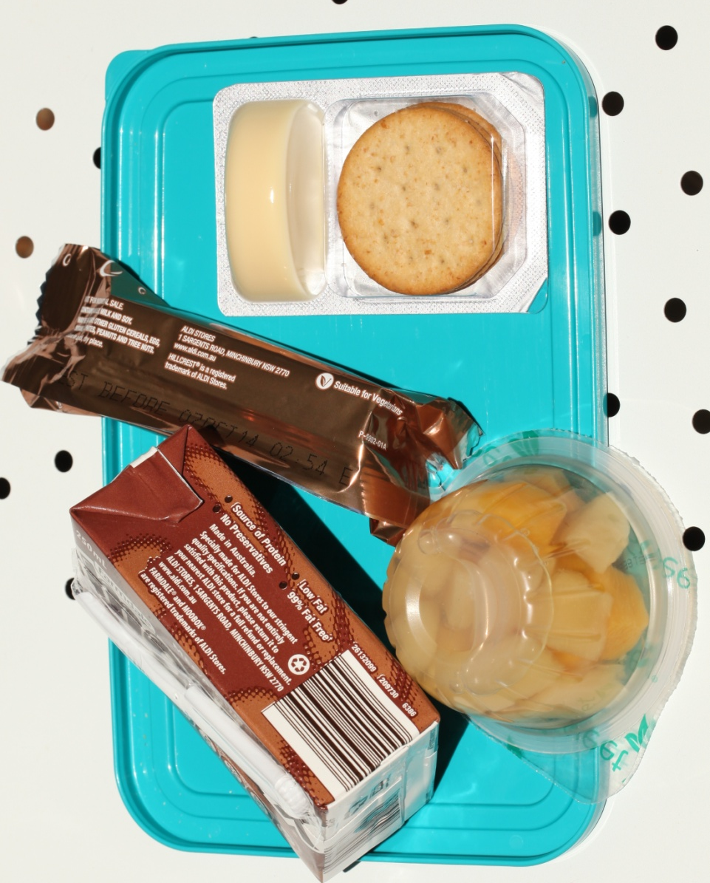
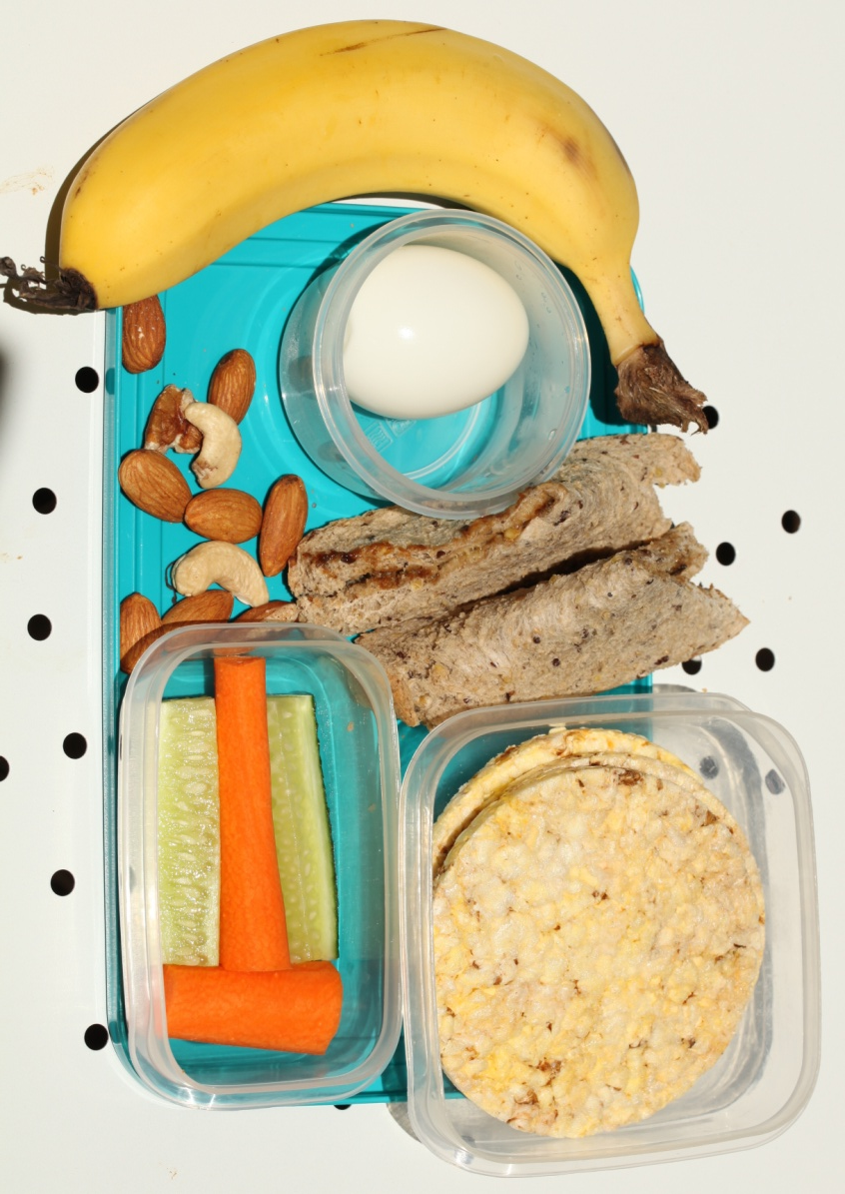
Which lunch is healthier?
All photo images — courtesy Narinda Sandry, used with permission

